Slide 1
Oscillators
CO-4
SESSIONS: 20 TYPE B 50 MIN
21 TYPE C 100 MIN
22 TYPE C 100 MIN

Slide 2
Objectives
Describe the basic concept of an oscillator
Discuss the basic principles of operation of an oscillator
Design and Analyze the operation of RC, LC and crystal oscillators

Slide 3
OSCILLATOR
Oscillator is an electronic circuit that generates a periodic waveform on its output without an external signal source. It is used to convert dc to ac.
Oscillators are circuits that produce a continuous signal of some type without the need of an input.
These signals serve a variety of purposes.
Communications systems, digital systems (including computers), and test equipment make use of oscillators

Slide 4

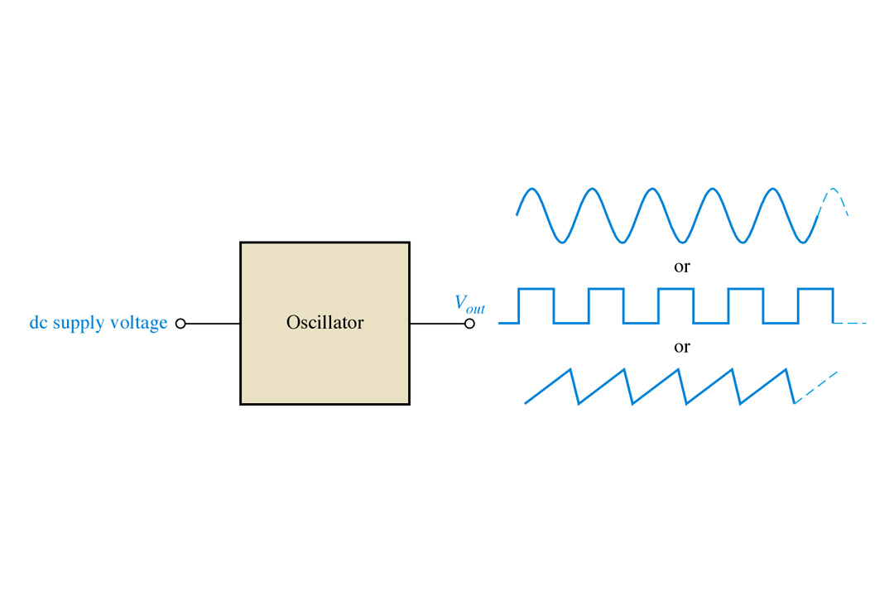

Sine wave
Square wave
Sawtooth wave
Need of an oscillator
  To test performance of electronic circuits, it is called signal generator.
  It can produce square, pulse, triangular, or sawtooth waveshape.
  High frequency oscillator are used in broadcasting.
  Microwave oven uses an oscillator.
  Used for induction heating and dielectric heating.

Slide 5
Application of Oscillators
Oscillators are used to generate signals, e.g.
  Used as a local oscillator to transform the RF signals to IF signals in a receiver
  Used to generate RF carrier in a transmitter
  Used to generate clocks in digital systems
  Used as sweep circuits in TV sets and CRO.

Slide 6

Video 1:
pendulum sinusoidal curve animation
Video 2:
MIT Physics Demo -- Spray Paint Oscillator

Slide 7
How does the oscillation get started?
Noise signals and the transients associated with the circuit turning on provide the initial source signal that initiate the oscillation

Slide 8
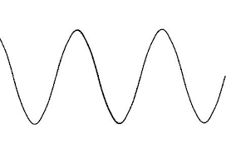
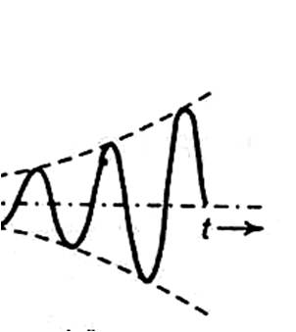
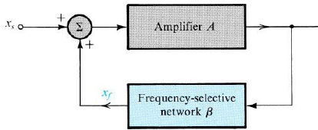
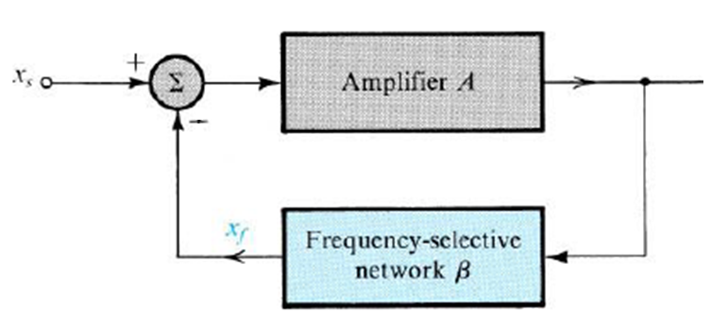
Amplifier Vs Oscillator
X_{s} =0
Generate periodic AC Output signal without any input signal by using only the DC supply voltage as an input.
Uses only positive feedback.

Slide 9
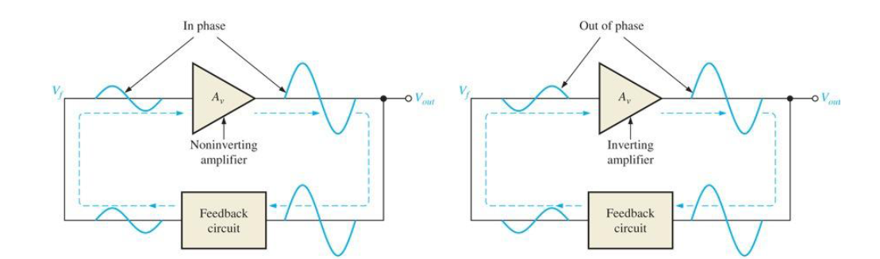
How to generate +ve feedback?

Slide 10
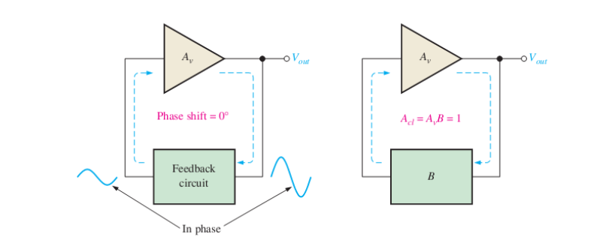
Barkhausen Criterion

Slide 11
Condition for Stability
For good frequency stability, the phase shift must be made a strong function of frequency at resonance that is, the Q factor should be high.
For good stability, the change in the gain with a change in the amplitude of output voltage v_{o} should be made large; an increase in amplitude must result in a decrease in gain.

Slide 12
Factors determining the frequency of oscillation
Oscillators can be classified into many types depending on the feedback components, amplifiers and circuit topologies used.
RC components generate a sinusoidal waveform at a few Hz to kHz range.
LC components generate a sine wave at frequencies of 100 kHz to 100 MHz.
Crystals generate a square or sine wave over a wide range,i.e. about 10 kHz to 30 MHz.

Slide 13


Classification
Sinusoidal (Radio frequency)
  LC
    Hatley
    Colpitt
  RC (Audio frequency)
    Wein bridge
    Phase shift
  Crystal
Non sinusoidal
  Multi vibrators
    Astable
    Mono stable
    Bistable
  Relaxation oscillators

Slide 14
R C Oscillators
Wien Bridge
R C Phase shift Oscillator

Slide 15
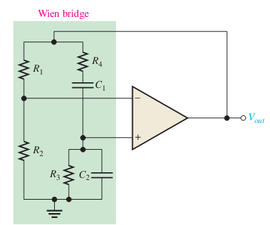
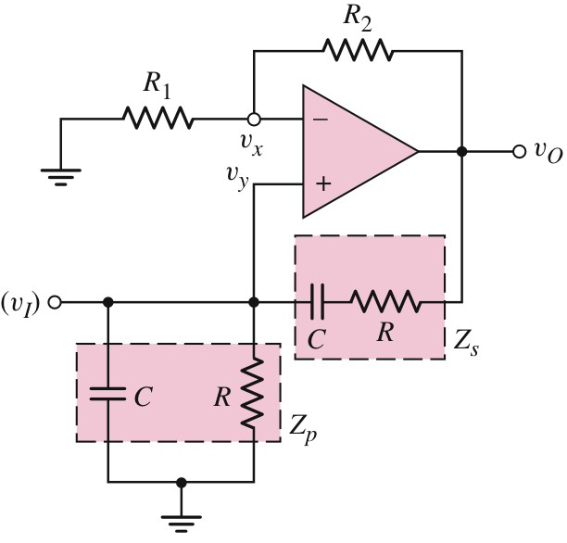
Wien Bridge oscillator

Slide 16
Wien Bridge oscillator
(20 Hz to 20 kHz)
Low frequency R C audio oscillator.
Uses Lead- Lag network in Feedback
Lag Circuit
Lead Circuit

Slide 17
Analysis
But at the frequency of oscillation, T(jω) must be real (for zero phase condition), the imaginary component must be zero;
By substituting the above in Eqn.1 for magnitude condition

Slide 18
Design Procedure
Choose C
Obtain suitable R depending on f_{0.}
Choose suitable R₁
Obtain R₂=2 R₁
Design a Wien bridge oscillator at 1 kHz and test the circuit using My Daq / Multisim.
C=0.01µF, R=15.915 k Ω; R₁=10k Ω; R₂=20k Ω

Slide 19
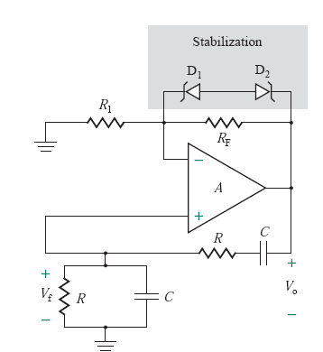
Gain Stabilization

Slide 20
Give it a Thought!!!
How can you obtain a square wave of same frequency from the above circuits?
Design a circuit to obtain triangular wave using the above circuits.

Slide 21
Phase Shift Oscillator
i
V_{f}
The phase shift oscillator utilizes three RC circuits to provide 180º phase shift

Slide 23
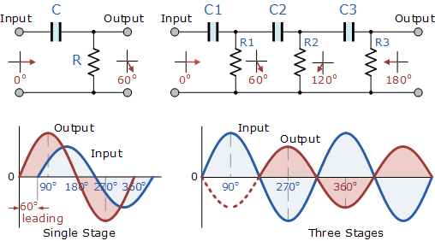
Working of Phase Shift Oscillator

Slide 24
Analysis

Slide 25
Design Procedure
Choose a suitable ‘C’
Obtain ‘R’ from given
Choose a suitable R₁= 10 R (To prevent loading)
Obtain R_{i} from
1. Design a R-C Phase shift oscillator at 400 Hz and test the circuit using My Daq / Multisim.
2. Verify the phase difference between various stages
C=0.1µF, R=1.624 k Ω; R₁= 16.24 k Ω; R_{F}=470.96 k Ω

Slide 26
Quiz
What happens if your interchange capacitor and resistors in R-C phase shifting network?
Minimum How many RC networks are to be used to produce the phase shift of 180 degrees?
What is the phase shift to be obtained by each stage of a four stage R-C Phase shift oscillator?
What are the de-merits of this oscillator.
Write a note on applications of Wien bridge and R-C Phase shift oscillators.

Slide 27
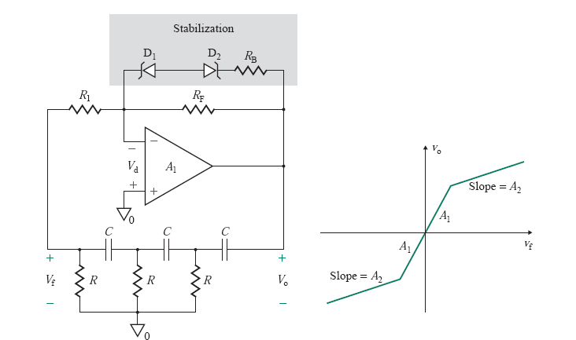
Gain stabilization

Slide 28
LC Oscillators
Use transistors and LC tuned circuits or crystals in their feedback network.
For hundreds of kHz to hundreds of MHz frequency range.
Examine Colpitts, Hartley and crystal oscillator.

Slide 29
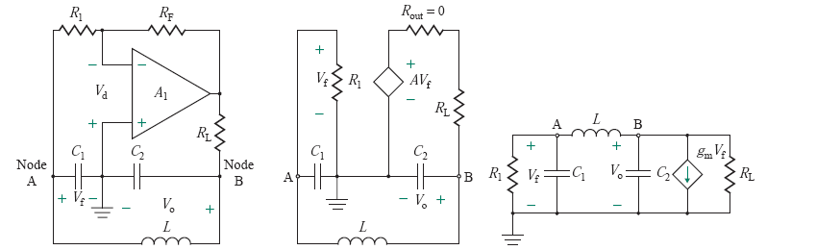
Colpitt’s Oscillator
(100 kHz to 100 MHz)

Slide 30


Analysis

Slide 31




If
…….1
Equating Imaginary part to zero

Slide 32



Equating Real part to zero
For large R_{L}

Slide 33
Design Procedure
Choose suitable values for C₁ and C₂
Calculate ‘L’ value from
Choose R_{L} and obtain
Calculate
Design a Colpitt’s oscillator at frequency of 150kHz and verify it using Multisim /MyDaq.

Slide 34
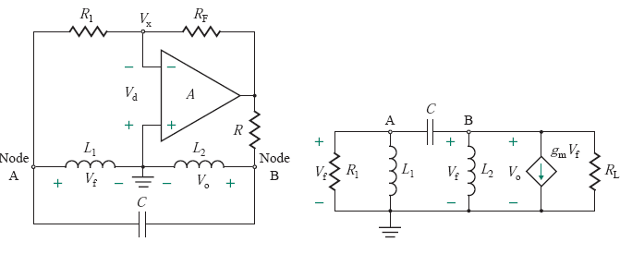
Hartley Oscillator
(20KHz to 30MHz)
Suitable for oscillations in RF (Radio-Frequency) range, up to 30MHZ
Used as radio receivers

Slide 35
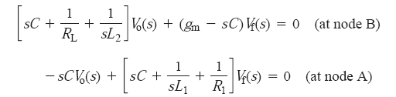


Equating Real part to zero

Slide 36




Equating Imaginary part to zero

Slide 37
Design Procedure
Choose suitable values for L₁ and L₂
Calculate ‘C’ value from
Obtain ; Assume g_{m}=3mA/V
Calculate
Calculate
Design a Hartley oscillator at frequency of 5 MHz and verify it using Multisim /MyDaq.

Slide 38
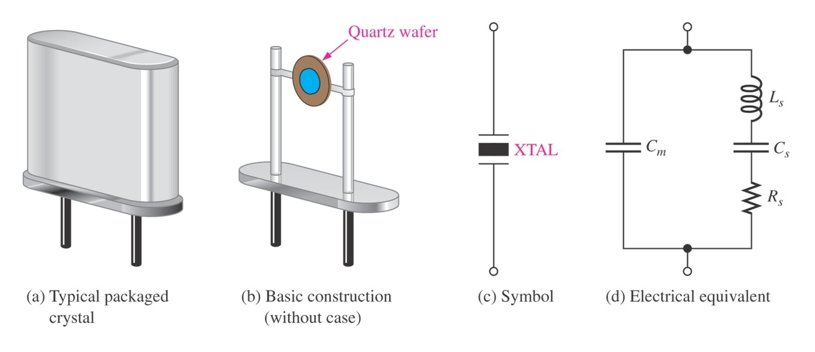
Crystal Oscillator
Most communications and digital applications require the use of oscillators with extremely stable output. Crystal oscillators are invented to overcome the output fluctuation experienced by conventional oscillators.
Crystals used in electronic applications consist of a quartz wafer held between two metal plates and housed in a a package as shown in Fig. 9 (a) and (b).

Slide 39
Crystal Oscillator
Piezoelectric Effect
  The quartz crystal is made of silicon oxide (SiO₂) and exhibits a property called the piezoelectric
  When a changing an alternating voltage is applied across the crystal, it vibrates at the frequency of the applied voltage. In the other word, the frequency of the applied ac voltage is equal to the natural resonant frequency of the crystal.
  The thinner the crystal, higher its frequency of vibration. This phenomenon is called piezoelectric effect.

Slide 40
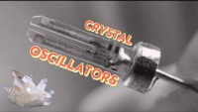
https://www.youtube.com/watch?v=fPKdDCiJDok

Slide 41
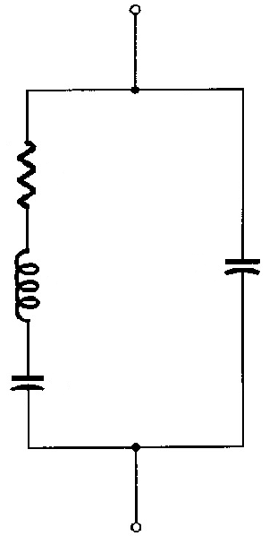
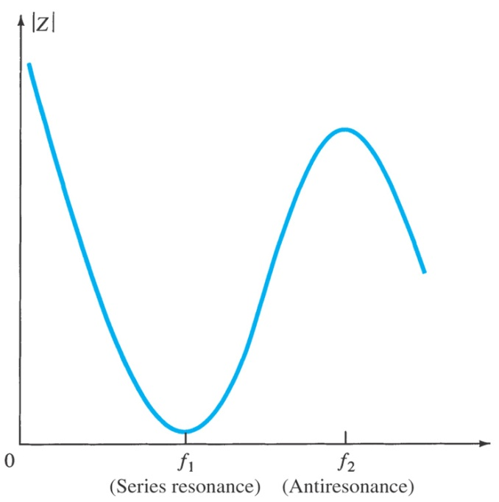
Crystal Oscillator
Characteristic of Quartz Crystal
  The crystal can have two resonant frequencies;
  One is the series resonance frequency f₁ which occurs when X_{L} = X_{C}. At this frequency, crystal offers a very low impedance to the external circuit where Z = R.
  The other is the parallel resonance (or antiresonance) frequency f₂ which occurs when reactance of the series leg equals the reactance of C_{M}. At this frequency, crystal offers a very high impedance to the external circuit
R
L
C_{M}
C

Slide 42
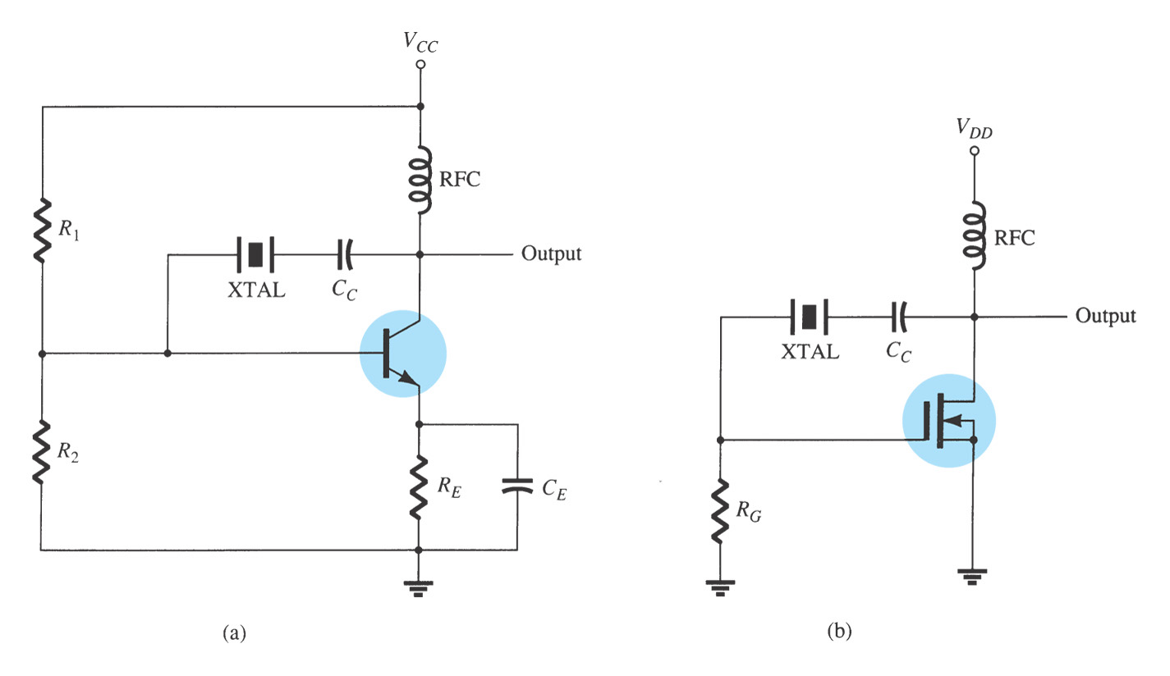
Crystal Oscillator
The crystal is connected as a series element in the feedback path from collector to the base so that it is excited in the series-resonance mode
BJT
FET

Slide 43
Crystal Oscillator
Since, in series resonance, crystal impedance is the smallest that causes the crystal provides the largest positive feedback.
Resistors R₁, R₂, and R_{E} provide a voltage-divider stabilized dc bias circuit. Capacitor C_{E} provides ac bypass of the emitter resistor, R_{E} to avoid degeneration.
The RFC coil provides dc collector load and also prevents any ac signal from entering the dc supply.
The coupling capacitor C_{C} has negligible reactance at circuit operating frequency but blocks any dc flow between collector and base.
The oscillation frequency equals the series-resonance frequency of the crystal and is given by:

Slide 44






Oscillator | Frequency of Oscillations
 | Using BJT | Using FET | Using OPAMP
RC Phase Shift Oscillator
Wien Bridge Oscillator
Hartley Oscillator
Collpitt’s Oscillator
Crystal Oscillator

